Slide 1
A-3 - Review
Main components of a computer
Memory
Registers
Input
Arithmetic
and
Logic
Interconnection
Network
Output
Control
Notes:
Registers and cache memory are part of the processor unit

Slide 2
What can the CPU do?
Data movement instructions: transfer data from memory to CPU and from CPU to memory, or between two registers
Arithmetic & “logic” operations on data (ALU instructions): such as ADD, SUB, AND, XOR, NEG, etc.
Program sequencing and control instructions: i.e., unconditional/conditional branches etc. (more on these later)
Input/output transfers (I/O instructions): transfer data from device to memory, or memory to device
THAT’S IT!
Even the most complex programs, even in the most powerful systems, consist only of these kinds of instructions!

Slide 3
Memory Operations: Data transfers
Memory contains both data and program instructions: As already discussed, everything must be encoded as a bit string including EVEN INSTRUCTIONS which will be executed by the processor/CPU!
Since everything is a bit string, the contents of a memory word is a string of 64 bits (or 32 bits in 32 bit systems)
Read (memory) instruction: Memory retrieves contents at address given by CPU; value in memory does not change (READ does not change bit string EVER!)
WRITE (memory) instruction: Memory overwrites contents at address given by CPU with data given by CPU; value overwritten is LOST (bits at that address change) (unless it has been preserved somewhere else before being overwritten)

Slide 4
Keeping track of next instruction
The CPU has to keep track of which instruction should be executed next (or, when the program begins, which instruction should be executed first)
Actually, the CPU keeps track of where in memory the instruction is, that is, the address of the instruction (An address is an index in the memory array).
This address is kept in a special register called the program counter, or PC (Know this!)
The CPU also has a register where an instruction (the bit string which encodes the instruction) must be stored in order to be executed; this is called the instruction register, or IR (Know this too!)

Slide 5
Assembly-Language Notation
Assembly language notation is used to represent machine instructions in a text form – rather than a bit string form (In this assembly language, what follows the % character is a comment) [NOTE: Do not worry about the details!]
Examples:
Load R2, 200 % Move bits from address 200 to
% register R2 Add R2, R3 % Add register R2 to register
% R3, and write result to register R3
These will be converted to machine language (bit strings!) by the assembler (a program which does this conversion)
Caution: These are not from an assembly language for a real CPU, but they are very similar to real ones
Notes:
R2 ← [200] is what *happens* when Load R2, 200 is executed (i.e., carried out) by the CPU; R4 ← [R2] + [R3] is what happens when Add R4, R2, R3 is executed.

Slide 6
NOTES ON ASSEMBLY LANGUAGE
Assembly language is a human readable form (text form) of machine language (bit strings of 0’s and 1’s which can be placed in memory and executed by a particular type of CPU)
Assembly language is TEXT (characters), just as high-level language code (such as Java, C++ or C, etc.) is text, but neither assembly language nor high-level language code can be executed by a CPU; only machine language code – bit strings – can be executed by a CPU!
Every instruction in assembly language corresponds to a single machine instruction; in high-level language code though (Java, C++, C, etc.), a statement typically corresponds to A NUMBER OF assembly language/machine language instructions (that is, MORE THAN ONE MACHINE INSTRUCTION).

Slide 7
Processor “Families”: RISC and CISC Instruction Sets
There are TWO LARGE GROUPS or “families” of CPUs: RISC and CISC
RISC: Reduced Instruction Set Computers: have one-word instructions and require arithmetic operands to be in CPU registers; so in RISC, CANNOT HAVE: add 100, 200 (adding words at addresses in memory)
CISC: Complex Instruction Set Computers: have variable length instructions (many multi-word instructions) and allow ALU operands can be in memory
RISC processors have a smaller instruction set (that’s why they’re called REDUCED instruction set computing CPUs).
We focus on RISC as it is simpler and cheaper (but CISC is easier to program)
Intel X86 and X86-64 are CISC processors; ARM is a RISC architecture (used in most/all tablets and cell phones), and so are the Apple M1, M2, M3, and M4 (based on ARM).
RISC processors use less power, but are more work to program (programs are longer)
Do you see why tablets and cell phones use RISC CPUs?

Slide 8
RISC Instruction Sets
Consider a typical high-level language statement: C = A + B;
We assume here that we have a 32 bit RISC CPU (to make things a little simpler); this means the word size is 32 bits.
A, B, and C (variables) correspond to memory locations … can’t do arithmetic on them in RISC (remember?); so first, have to move them to registers, do the ALU operation, and then move the result back to memory:
Load R2, A % move A to reg R2 Load R3, B % move B to reg R3 Add R4, R2, R3 % add R2 and R3, and
% write sum to reg R4 Store R4, C % move sum from R4 to C
% in memory
This is assembly language; assembler will convert to machine language (including replacing A, B, C by corresponding addresses)
Notes:
This can be done with a single instruction, “Add C, A, B”, in CISC

Slide 9
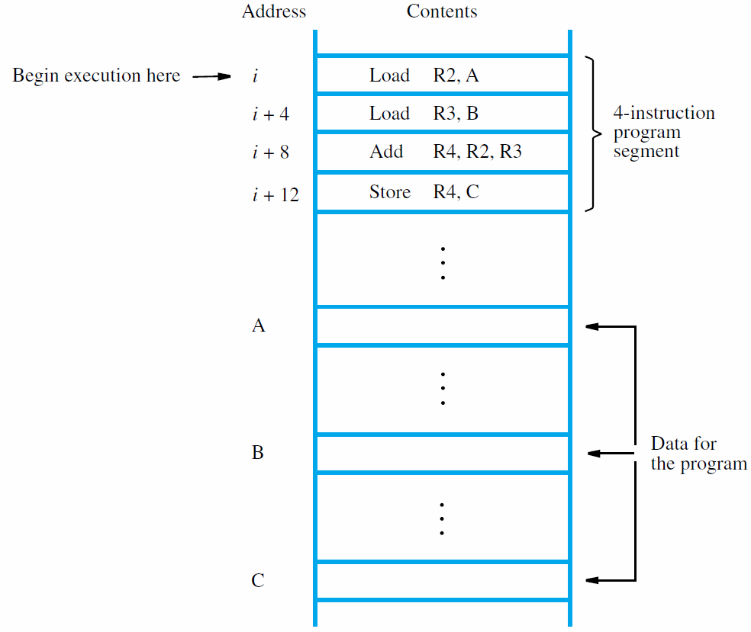
Memory address
Memory content
A, B, C will be actual addresses; e.g., A might be i+1000, B might be i+1004 (why?) and C might be i+1008
Assembler’s main tasks:
Decide the address corresponding to A, B, C; convert each instruction into corresponding machine language version

Slide 10
RISC Instruction Sets (cont.)
RISC is also called Load/Store architecture, because the only CPU instructions that can access memory are load (move from memory to register) and store (move from register to memory)
NOTICE: In the example above, a single high-level language statement requires multiple assembly language instructions. This is usually true (almost always).

Slide 11
Instruction length
Notice on slide 9, how each instruction requires one word in memory (4 bytes in this assembly language)
As we said before, this is always true in RISC processors: one-word instructions
In CISC processors, instructions may be one word, but many types of instructions are two, three, or more words (variable instruction length)

Slide 12
How is the program executed?
CPU’s program counter (PC) register has address i of the first instruction
Control circuits “fetch” (read) the contents of the location at that address (more on this later)
The instruction is then “decoded” and executed (more later)
During execution of each instruction, PC register is incremented by 4 (assuming all instructions are 4 bytes) after instruction is fetched from memory, so PC now has address of next instruction
PC contents are i + 16 after store instruction (last instruction in this example code) is executed
More details later

Slide 13
No “if” or “if-else” instructions in assembly!
Simple example problem: Assign larger of A and B to C
(assume A, B not equal)
In C++ (or other high-level langs.): if (A > B) { C = A; } else { C = B; }
Notes: 1) Labels followed by a colon: each label marks an address in program
2) Comments preceded by %
In machine (assembly) language: use conditional branches:
Load R1, A Load R2, B Sub R3, R1, R2 BLZ B1 %Branch < 0
Store R1, C
BR B2 %Branch B1: Store R2, C
B2: …. %Next instruction
Branches are implemented by changing value in PC
Conditional branches use the PSR (Processor Status Register)

Slide 14
Notes on Prior Slide
Branches (also called Jumps):
BLZ is "Branch Less than Zero,", which will go to the label in the instruction to execute the next instruction if the last ALU result was less than zero.
BR is "Branch" (unconditional), which will go to the label to execute the next instruction without any condition (such as "last ALU result was less than zero")

Slide 15
Processor Status Register (PSR)
Four 1 bit flags (also called condition codes) in the Processor Status Register, which we will discuss in more detail later (the C and O flags we mentioned before are 2 of these flags).
These flags are used by the processor to store information about the result of executing an ALU instruction.

Slide 16
Flags in PSR
We will only be interested in 4 flags (we already saw the last two of the ones shown below):
S – Sign flag: Set to 1 by the processor if the result of the last ALU operation was negative (if the msb of the result was 1); otherwise, set to 0.
Z – Zero flag: Set to 1 by the processor if the result of the last ALU operation was 0 (if all the bits of the result were 0); otherwise, set to 0.
C – Carry flag: Set to 1 if the result of the last instruction generated a carry of 1 from the operation on the most significant pair of operand bits; otherwise, set to 0.
O – Set to 1 if the result of the last instruction generated a carry from the operation on the most significant pair of operand bits different from the carry from the operation on the second most significant pair of bits (that is, if last two carries are different); otherwise, set to 0.

Slide 17
No loops in assembly! Use branch instructions
Problem: Add list of N numbers
Solution:
Load R2, N %Load size of list at label N Clear R3 %Set R3 to 0 - will contain sum Load R4, #Num %Address of 1st no. at label Num
L1: Add R3, (R4) %Add next no. to sum
Add R4, #4 %Inc address in R4
Sub R2, #1 %Decrement counter
BGZ L1 %Branch back if not done
Store R3, Sum %Result!
Loops, conditionals etc. all implemented with branches
Different addressing modes: N, #Num, (R4) etc.; more details as we go along …
Operands with # are constants (either data operands or addresses of data in memory) encoded in the machine language instruction by the assembler.
NOTE: A register in parentheses, for example (R4), treats the value in the register as an address of data in memory, and will either read the data at that address, or write (overwrite) data to that address.

Slide 18
Labels in code on prior slide
There are 4 labels used in the instructions in the code on the prior slide (3 of the labels are not shown in the code): N, Num, Sum, L1
Labels are used to mark addresses (like bookmarks in a book):
where data is stored (N, Num, Sum), or
where a branch/jump target is located (where the code might branch to for a branch instruction)
Labels that mark addresses are followed by a colon symbol (:), for example, L1 is in the code on the prior slide, and matks the address of the instruction
Add R3, (R4)

Slide 19
Labels in code on prior slide (contd)
When the assembler converts the assembly language code to machine language, a label in an instruction (e.g., BGZ L1) will be replaced by the corresponding address.
NOTICE 2 different uses of labels:
Load R2, N %Loads data at label N (variable)
Load R4, #Num %Loads address of label Num % (constant)
Labels use no space in memory, because they are NOT data; they are just symbolic markers of addresses (like a bookmark).
An assembly language for every CPU uses labels

Slide 20
Data Structures …
NO built-in data structures in hardware … remember everything is “just” a bit string!
The programmer has to store the information in an appropriate set of memory words and remember the details … (keep track of where the data is by using variable names (also marked with labels in assembly language)
In loop example, we stored an array of numbers in a sequence of memory words starting at the location of the label Num

Slide 21
Functions, procedures, methods …
(Usually called “subroutines” (in assembly/machine language)…; these are functions/procedures/methods, etc.)
All programs just consist of one or more subroutines
Key point: some task may have to be done many times using different sets of data …
Example: Computing math functions, sorting lists, etc.
So: Implement task in one block of instructions; this is the subroutine
Where needed, use a subroutine call … like a branch/jump but more complex (because execution will eventually return – or go back to - the instruction after the instruction from which the call was made)

Slide 22
Subroutines (contd)
Can’t just have “BR Sub” (label for subroutine) … why not?
Need to save return address so can come back to the right place when subroutine Sub finishes
We know that in a high-level language, when we call a function/method, after the code for the called subroutine completes, the program will return to the instruction immediately after the instruction where the call was made.
Some machines use a single link register to save return address … BUT that doesn’t always work (Why not?)
Moreover, need a way to pass parameters to the subroutine and get back results
Standard approach: use a specific area of memory (called the “stack”) for this.

Slide 23
Stack frame
Each subroutine S that is called is “allocated” (given) a stack frame – a contiguous set of memory words that is used as space for the parameters passed to S, the return address, the local variables of S, and the starting address (beginning) of the caller’s stack frame
During the execution of S, a specific register, that might be called RSP (Register Stack Pointer), will contain the starting address of S’s stack frame; in other words, this register is used as a “top of stack” (TOS) pointer
Structure of the stack during execution: more later – see description of Y84-64 in next two slide sets (based on Intel X86-64.

Slide 24
Subroutine example
Suppose we want a subroutine Sum that can be used to add any sequence of numbers (i.e., an array) with a variable (unknown) number of numbers
The Sum subroutine needs two parameters:
The address of the seq. of numbers to be added
The number of elements in the array
The “calling code” is responsible for putting this information and the return address in Sum’s stack frame and then calling Sum
Sum will compute the result, store it in R1 (the return register), and “return” to the caller

Slide 25
Subroutine: caller, callee
% caller code
% 10 nos. to be added;
% they are at N, N+4, …
Load R2, Size %array size in R2
Load R3, #N %array addr in R3
Push R3 %push addr parameter
Push R2 %push size parameter
Call Sum %Push return address %back to here on top of stack; and
%then call Sum subroutine
…... %Following code here
NOTE: Push instructions write copy of data in register being pushed on top of stack
Sum : %subroutine label
Load R2, (RSP) %get array size
Clear R1 % sum = 0
Load R4, 4(RSP) %get start addr
L1: Add R1, (R4) %Add next num
Add R4, #4 %Inc address in R4
Sub R2, #1 %Dec counter
BGZ L1 %Branch back if not
%Done
RET %Done! Return to
%caller
NOTE: Constant values are preceded by the symbol #, e.g., Add R1, #4
Constant values are stored in the encoded instruction (as part of the bit string!)

Slide 26
Stack frame (contd)
In general:
For every subroutine call, there are two subroutines involved: the caller subroutine calls the callee subroutine.
Caller puts parameters (if any) for callee in frame of callee; when caller calls callee, address of next instruction after call instruction will be pushed onto the stack.
Callee uses the information as needed, uses additional space in its frame as needed, computes needed results and puts them in the appropriate return register and returns to the address pushed by caller when call was executed.
After return from callee, caller can get result (if any) from return register and continue/proceed with its work.

Slide 27
Stack frame (contd)
This is a very general and very important scheme and used virtually universally
We will keep coming back to it
Other key points:
Registers may be used to pass parameters and get back results but using the stack frame is more general, and most systems do it this way
Recursion is automatically handled by stack frames (the same subroutine can be both caller and callee)
Indirect addressing such as in “Add R1, (R4)” is very important and is the equivalent of pointers in languages such as C/C++ (and Java, though they are not called pointers in Java)

Slide 28
Next
Y86-64 assembly language for a simulated processor, which we can run on a simulator (a program that acts like a CPU).
Similar to (nearly the same as) assembly language for Intel X86-64 64 bit processors in many important ways, but much simpler.

